Slide 1


Department of Information Engineering
Master’s Degree in Computer Engineering
Development of an IR system for argument search Touché Task 1: Argument Retrieval for Controversial Questions
HyperGroup / Jean Pierre Polnareff
Marco Alecci, Tommaso Baldo, Luca Martinelli, Elia Ziroldo
ACADEMIC YEAR 2020/2021

Slide 2
Introduction
Task 1: Supporting debates on controversial topics
Scenario:
Users search for arguments on controversial topics
Task:
Retrieve “strong” pro/con arguments on the topic
Data:
args.me corpus, a collection of documents extracted from web debate portals

Slide 3
Related works: overview of Touché 2020
General Strategy:
Base retrieval model
LMDirichlet and BM25 most used
LMDirichlet and DPH most performant
Augmentation
Query expansion
Result expansion
Re-ranking
Argument quality
Sentiment analysis
Team | Retrieval | Augmentation | (Re)ranking Feature
Dread Pirate Roberts | DirichletLM/Similarity-based | Language modeling
Weiss Schnee | DPH | Embeddings | Quality
Prince of Persia | Multiple models | Synonyms | Sentiment
The Three Mouseketeers | DirichletLM
Swordsman (Baseline) | DirichletLM
Thongor | BM25/DirichletLM
Oscar François de Jarjayes | DPH/Similarity-based |  | Sentiment
Black Knight | TF-IDF | Cluster-based | Stance, readability
Utena Tenjou | BM25
Arya Stark | BM25
Don Quixote | Divergence from Randomness | Cluster-based | Quality + Similarity
Boromir | Similarity-based | Topic modeling | Author credibility
Aragorn | BM25 |  | Premise prediction
Zorro | BM25 |  | Quality + NER

Slide 4

Methodology
Pre-processing of the documents
BM25 and LMDirichlet
Different strategies, first separately than merged:
Different weight to different fields of the document
Query expansion using synonyms extracted from WordNet
Re-ranking based on sentiment analysis on the documents

Slide 5
Pre-processing
Classic Tokenizer
LowerCaseFilter and LengthFilter
Custom filter: MultipleCharFilter

Slide 6
Pre-processing: choice of stoplist
Stock stoplists | Number of words | nDCG@5
tent1 | 400 | 0.5599
Air3z4 | 1298 | 0.5757
zettair | 469 | 0.5790
smart | 571 | 0.5895
terrier | 733 | 0.5919
cook | 221 | 0.6043
taporwave | 485 | 0.6068
postgre | 127 | 0.6078
nltk | 153 | 0.6078
lexisnexis | 100 | 0.6131
NO STOPLIST | 0 | 0.6189
corenlp | 28 | 0.6211
okapi | 108 | 0.6224
ranksnl | 32 | 0.6249
lucene_elastic | 33 | 0.6256
ovid | 39 | 0.6259
lingpipe | 76 | 0.6260
EBSCOhost | 24 | 0.6265
Different stock stoplists
Best scores with shorts stoplists
Max score: EBSCOhost

Slide 7
Pre-processing: custom stoplist
Custom stoplists | Number of words | nDCG@5
150_custom | 150 | 0.6066
ebsco+10 | 34 | 0.6258
ebsco+20 | 44 | 0.6258
ebsco+30 | 54 | 0.6123
150_custom: 150 most frequent terms in the index
Ebsco+x: ebsco stoplist with respectively the 10, 20 and 30 most frequent terms in the index (not already in the stoplist)

Slide 8
Pre-processing: stemmers
Stem Filter | nDCG@5
No Stem | 0.6265
English Minimal Stem | 0.6184
Krovetz Stem | 0.5747
Porter Stem | 0.5401
Adding complexity to the system, the score obtained decreases, this probably due to limitations of stemmers used

Slide 9
Strategies

Slide 10
1) Different weights to fields
Three differents fields: Body, Premises, Conclusions
All combinations of weights tested from 0 to 1, with a step of 0.25
BM25
LMDirichlet
Body | Premises | Conclusions | nDCG@5
0.0 | 1.0 | 0.25 | 0.4150
0.25 | 1.0 | 0.25 | 0.4143
0.5 | 1.0 | 0.25 | 0.4032
0.5 | 0.75 | 0.25 | 0.4029
0.25 | 0.75 | 0.25 | 0.4023
Body | Premises | Conclusions | nDCG@5
0.25 | 1 | 0 | 0.7379
0 | 1 | 0 | 0.7345
0.25 | 0.75 | 0 | 0.7331
0.5 | 1 | 0 | 0.7239
0.5 | 0.75 | 0 | 0.7123

Slide 11
2) Query expansion: synoynms
Synonyms Weight | BM25 | LMDirichlet
No synoynms | 0.3938 | 0.6339
0.1 | 0.4113 | 0.6185
0.2 | 0.4159 | 0.5977
0.3 | 0.3973 | 0.5913
0.4 | 0.3898 | 0.5267
0.5 | 0.3764 | 0.4731
0.6 | 0.3596 | 0.4273
0.7 | 0.3304 | 0.3847
0.8 | 0.2931 | 0.3406
0.9 | 0.2584 | 0.2892
1.0 | 0.2253 | 0.2564
Add synonyms to query before the search
WordNet: lexical database of semantic relations between words

Slide 12
3) Re-Ranking: Sentiment analysis
Compute a value between -1 and 1 for each argument:
Greater than zero: positive sentiment
Lower than zero: negative sentiment
Two approaches tried both on Conclusions and Premises:
Priorities to neutral documents
Priorities to emotional documents
Premises
Conclusions
Premises | BM25 | LMDirichlet
No sentiment | 0.3938 | 0.7345
Neutral is better | 0.0811 | 0.0569
Emotional is better | 0.4362 | 0.6952
Conclusion | BM25 | LMDirichlet
No sentiment | 0.3938 | 0.7345
Neutral is better | 0.0811 | 0.0569
Emotional is better | 0.1423 | 0.1414

Slide 13
Results
Run | BM25 | LMDirichlet
Base | 0.3938 | 0.7345
Best different fields weights | 0.4698 | 0.8026
Best query expansion with synonyms | 0.4159 | 0.6986
Best re-ranking with sentiment analysis | 0.4362 | 0.6952
Merging all three strategies | 0.4521 | 0.6661
BM25: all scores improved
LMDirichlet: Query expansion and Re-ranking do not work well
LMDirichlet better than BM25

Slide 14
Statistical Analysis

Slide 15
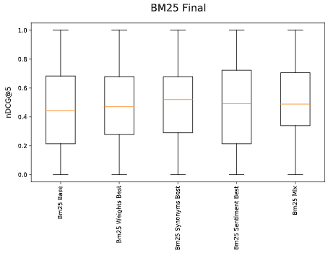
BM25 Best Runs
2)ANOVA Test:
p-value = 0.846705
1) Boxplots
3) Multiple pairwise comparison (Tukey’s HSD Test)
run1 | run2 | p-value
BM25 Base | BM25 Weights Best | 0.9
BM25 Base | BM25 Synonyms Best | 0.9
BM25 Base | BM25 Sentiment Best | 0.9
BM25 Base | BM25 Mix | 0.749016
BM25 Weights Best | BM25 Synonyms Best | 0.9
BM25 Weights Best | BM25 Sentiment Best | 0.9
BM25 Weights Best | BM25 Mix | 0.9
BM25 Synonyms Best | BM25 Sentiment Best | 0.9
BM25 Synonyms Best | BM25 Mix | 0.9
BM25 Synonyms Best | BM25 Mix | 0.9

Slide 16
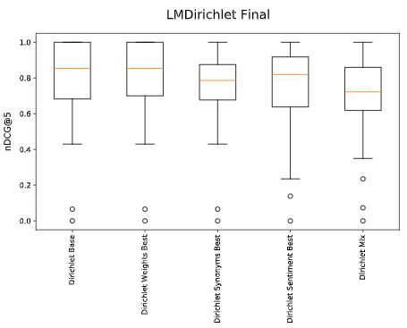
LMDirichlet Best Runs
2)ANOVA Test:
p-value = 0.268872
1) Boxplots
3) Multiple pairwise comparison (Tukey’s HSD Test)
run1 | run2 | p-value
Dirichlet Base | Dirichlet Weights Best | 0.9
Dirichlet Base | Dirichlet Synonyms Best | 0.9
Dirichlet Base | Dirichlet Sentiment Best | 0.81592
Dirichlet Base | Dirichlet Mix | 0.372886
Dirichlet Weights Best | Dirichlet Synonyms Best | 0.829768
Dirichlet Weights Best | Dirichlet Sentiment Best | 0.718983
Dirichlet Weights Best | Dirichlet Mix | 0.279774
Dirichlet Synonyms Best | Dirichlet Sentiment Best | 0.9
Dirichlet Synonyms Best | Dirichlet Mix | 0.857612
Dirichlet Synonyms Best | Dirichlet Mix | 0.9

Slide 17
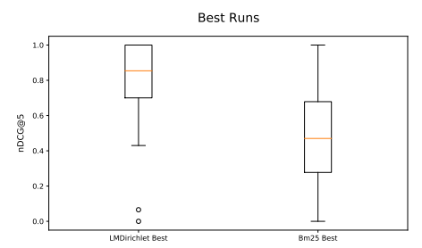
BM25 vs LMDirichlet
Boxplots
T Student Test:
p-value = 6.168497𝑒−09
Confirm that LMDirichlet model is better than BM25 for argument retrieval

Slide 18
Failure Analysis

Slide 19

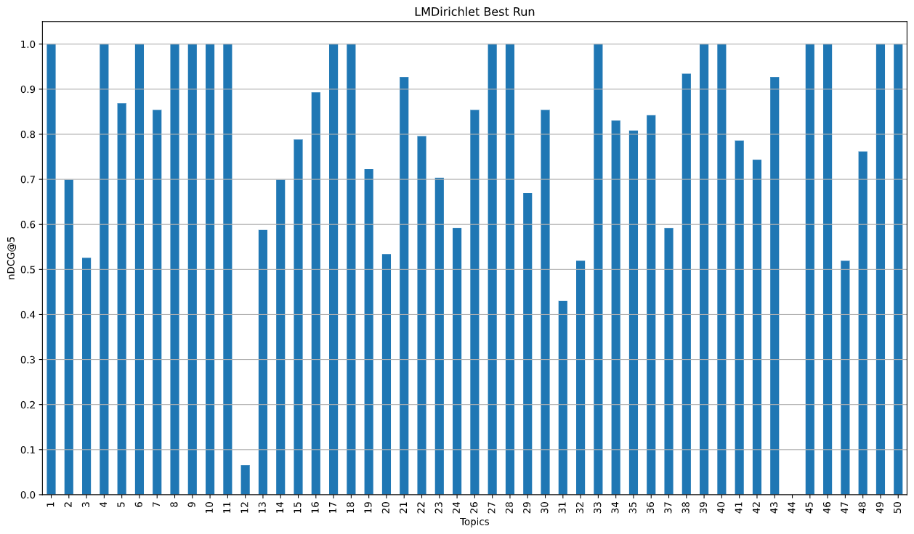
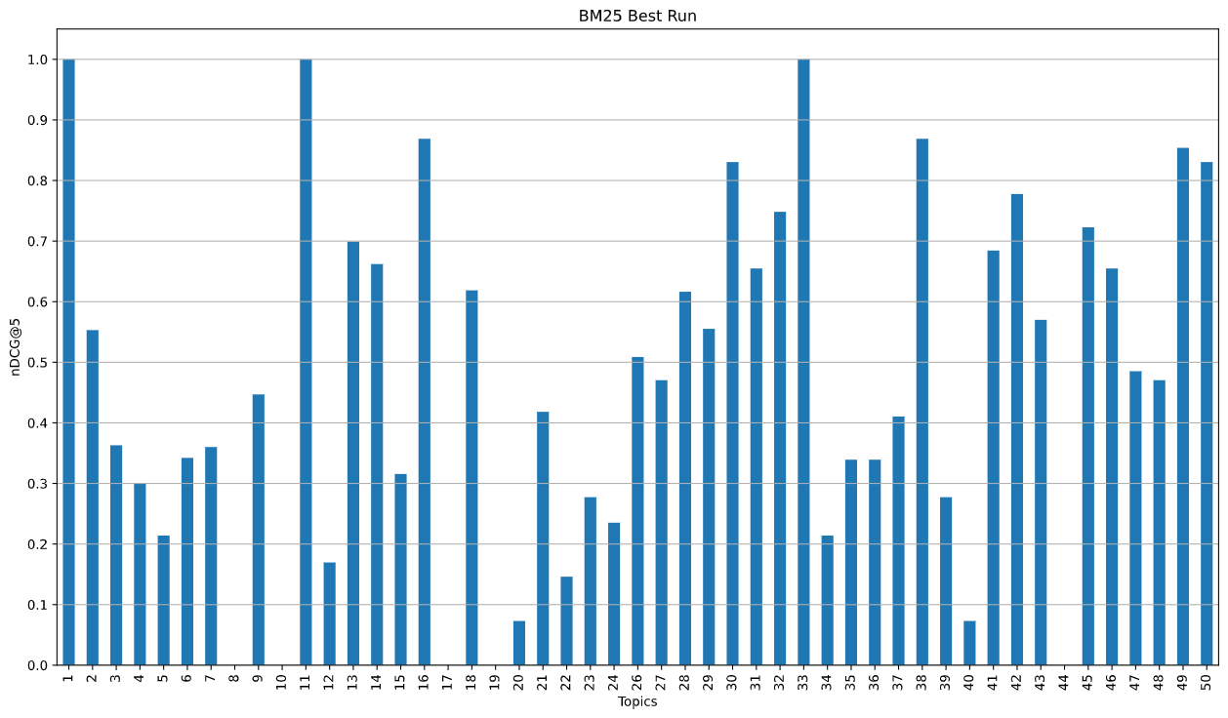
Failure Analysis
nDCG@5 score for each topic:
Best run using LMDirichlet
Best run using BM25
Worst topics:
Topic 44: Should election day be a national holiday?
Topic 12: Should birth control pills be available over the counter?

Slide 20
Conclusions and future works
Conclusions:
Right weight to each field of the document
LMDirichlet better than BM25
Improvements:
Weight for each synonym of a specific word
Change formula to re-rank documents
Future works:
Machine Learning

Slide 21
Thanks for your attention

